Slide 1
Recommender Systems
(2021, AlgoExpert)
Yang Xi’s Reading Note

Slide 2
Table of Content
Collaborative Filtering (CF)
User-based and Item-based CF
Memory-based Recommender System
Matrix Factorization, Implicit Rating, Alternative Least Square
Deep Learning Extension
Challenges of CF
Cold-Start
Echo Chamber
Shilling Attacks
Content-Based Filtering
Deep Learning Hybrid

Slide 3
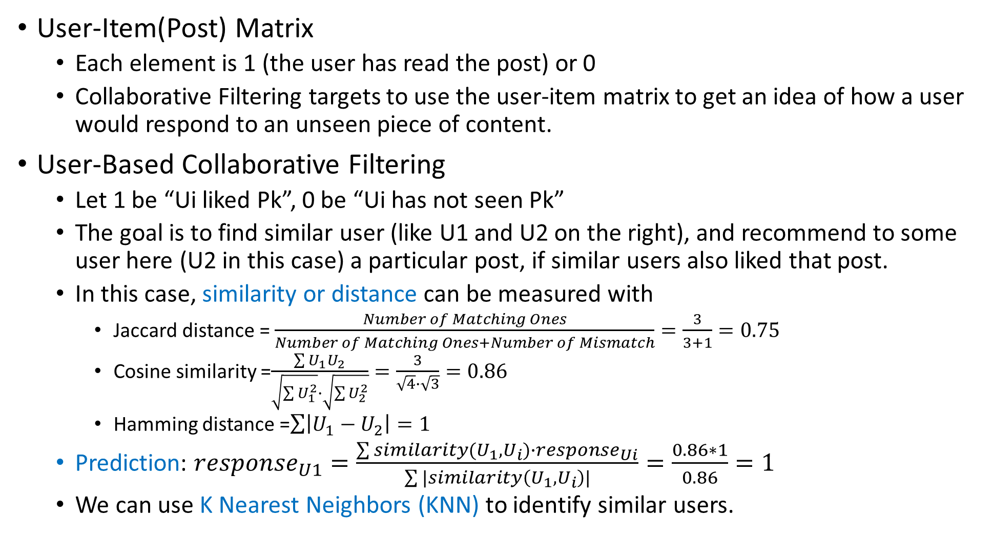
Collaborative Filtering
 | P1 | P2 | … | P[K]
U1
U2
…
U[N]
User-Item(Post) Matrix
Each element is 1 (the user has read the post) or 0
Collaborative Filtering targets to use the user-item matrix to get an idea of how a user would respond to an unseen piece of content.
User-Based Collaborative Filtering
Let 1 be “Ui liked Pk”, 0 be “Ui has not seen Pk”
The goal is to find similar user (like U1 and U2 on the right), and recommend to some user here (U2 in this case) a particular post, if similar users also liked that post.
In this case, similarity or distance can be measured with
Jaccard distance = $\frac{Number of Matching Ones}{Number of Matching Ones+Number of Mismatch}=\frac{3}{3+1}=0.75$
Cosine similarity =$\frac{\sum{U_{1}U_{2}}}{\sqrt{\sum{U_{1}^{2}}}∙\sqrt{\sum{U_{2}^{2}}}}=\frac{3}{\sqrt{4}∙\sqrt{3}}=0.86$
Hamming distance =$\sum{\left|U_{1}−U_{2}\right|}=1$
Prediction: $response_{U1}=\frac{\sum{similarity(U_{1},U_{i})∙response_{Ui}}}{\sum{|similarity\left(U_{1},U_{i}\right)|}}=\frac{0.86∗1}{0.86}=1$
We can use K Nearest Neighbors (KNN) to identify similar users.
 | P1 | P2 | P3 | P4 | P5
U1 | 1 | 0 | 1 | 1 | 1
U2 | 1 | 0 | 1 | 0 | 1

Slide 4
Collaborative Filtering
 | P1 | P2 | P3 | P4 | P5
U1 | 3 | 1 | 4 | 1 | 2
U2 | 2 | 1 | 4 | 0 | 2
User-Based Collaborative Filtering
Let’s use ratings: 5 is max, 1 is min, 0 is not seen
Similarity or distance:
Euclidean Distance
Manhattan Distance
Person Correlation: account for the optimism in a user’s ratings across all different products (some users always rate 1 to3, while some users only rate 3 to 5)
Cosine Similarity
We can use Mean Squared Error (MSE) to evaluate our predictions
Summary:
Find KNN of Ui to form prediction for
Select a similarity measure
Use the KNN data, predict the response for Ui
Recommend to Ui the item(post) which outputs the highest predicted value

Slide 5
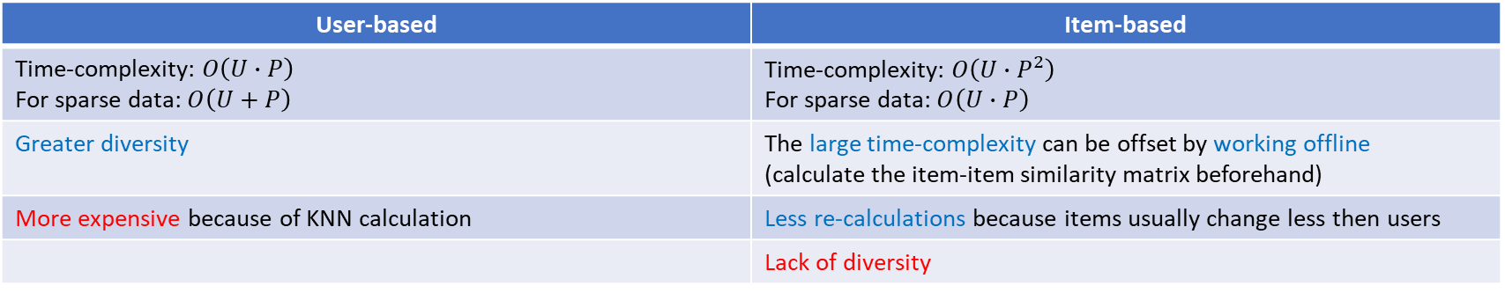
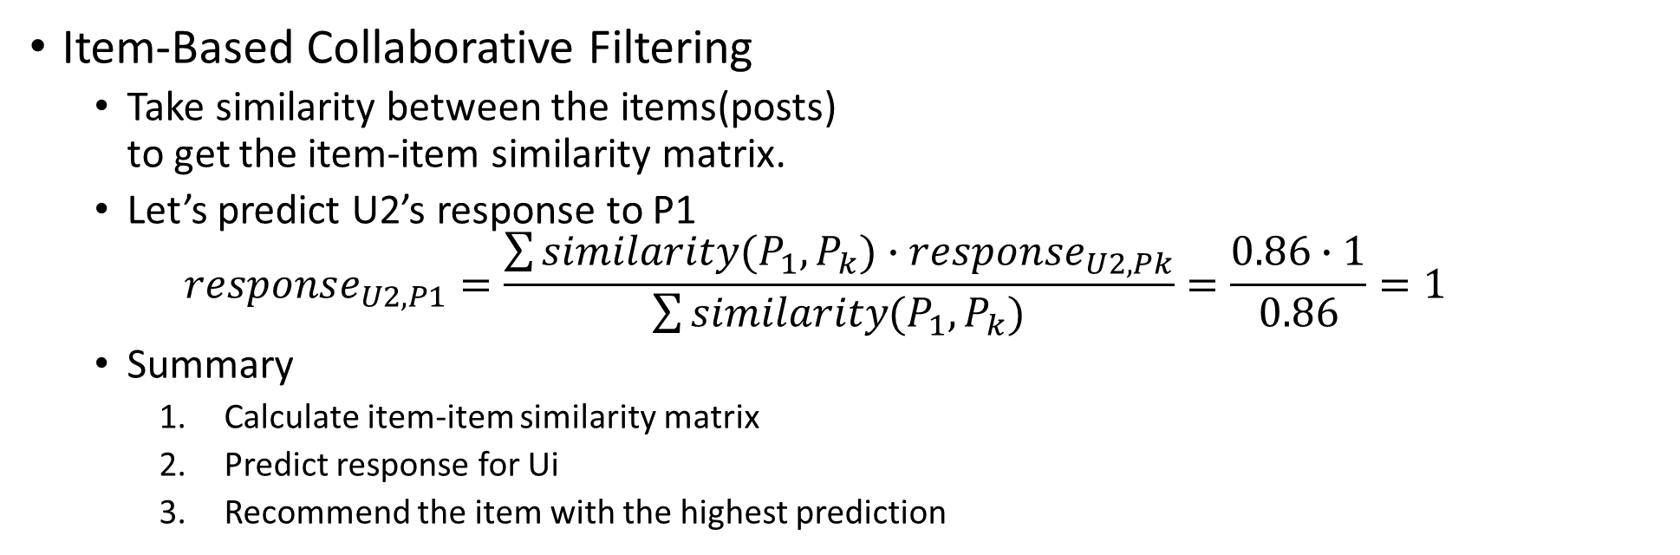
Collaborative Filtering
 | P1 | P2
U1 | 1 | 1
U2 | 0 | 1
U3 | 1 | 1
U4 | 1 | 1
U5 | 0 | 0
 | P1 | P2
P1 | 1 | 0.86
P2 | 0.86 | 1
Item-Based Collaborative Filtering
Take similarity between the items(posts) to get the item-item similarity matrix.
Let’s predict U2’s response to P1 $response_{U2,P1}=\frac{\sum{similarity(P_{1},P_{k})∙response_{U2,Pk}}}{\sum{similarity(P_{1},P_{k})}}=\frac{0.86∙1}{0.86}=1$
Summary
Calculate item-item similarity matrix
Predict response for Ui
Recommend the item with the highest prediction
User-based | Item-based
Time-complexity: $O\left(U∙P\right)$ For sparse data: $O\left(U+P\right)$ | Time-complexity: $O\left(U∙P^{2}\right)$ For sparse data: $O\left(U∙P\right)$
Greater diversity | The large time-complexity can be offset by working offline (calculate the item-item similarity matrix beforehand)
More expensive because of KNN calculation | Less re-calculations because items usually change less then users
 | Lack of diversity

Slide 6
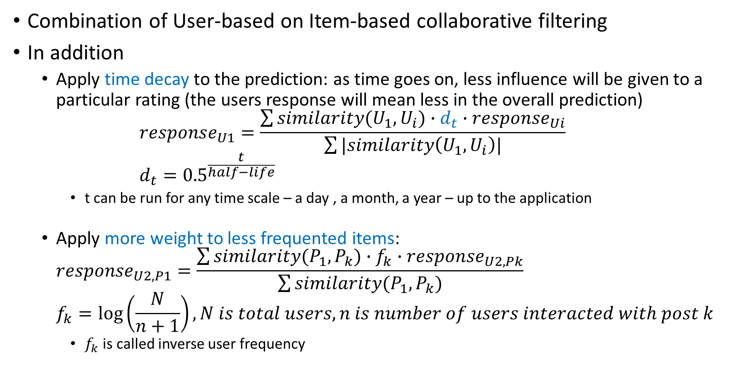
Memory-based Recommender System
Combination of User-based on Item-based collaborative filtering
In addition
Apply time decay to the prediction: as time goes on, less influence will be given to a particular rating (the users response will mean less in the overall prediction) $response_{U1}=\frac{\sum{similarity(U_{1},U_{i})∙d_{t}∙response_{Ui}}}{\sum{|similarity\left(U_{1},U_{i}\right)|}}$ $d_{t}={0.5}^{\frac{t}{half−life}}$
t can be run for any time scale – a day , a month, a year – up to the application
Apply more weight to less frequented items: $response_{U2,P1}=\frac{\sum{similarity(P_{1},P_{k})∙f_{k}∙response_{U2,Pk}}}{\sum{similarity(P_{1},P_{k})}}$ $f_{k}=\log\left(\frac{N}{n+1}\right),N is total users, n is number of users interacted with post k$
$f_{k}$ is called inverse user frequency

Slide 7
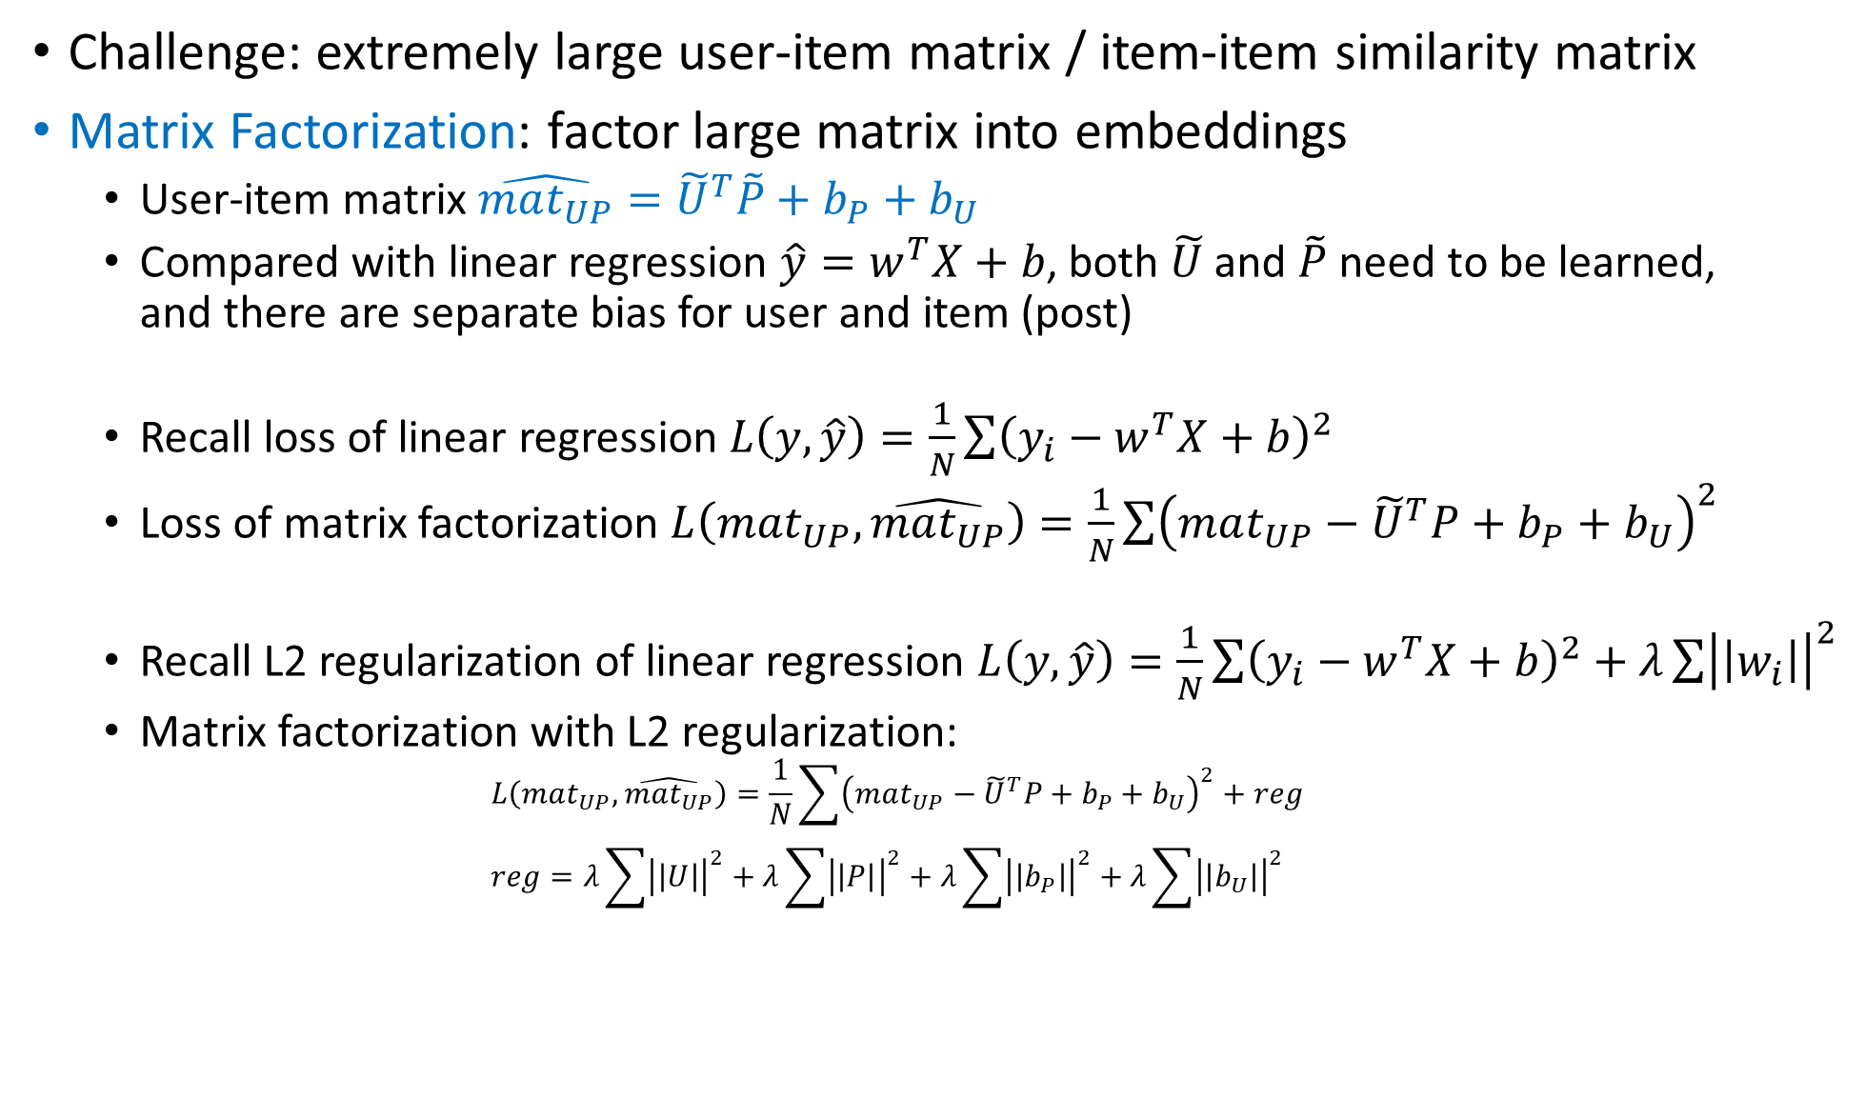
Memory-based Recommender System
Challenge: extremely large user-item matrix / item-item similarity matrix
Matrix Factorization: factor large matrix into embeddings
User-item matrix $\hat{mat_{UP}}={\tilde{U}}^{T}\tilde{P}+b_{P}+b_{U}$
Compared with linear regression $\hat{y}=w^{T}X+b$, both $\tilde{U}$ and $\tilde{P}$ need to be learned, and there are separate bias for user and item (post)
Recall loss of linear regression $L\left(y,\hat{y}\right)=\frac{1}{N}\sum{{\left(y_{i}−w^{T}X+b\right)}^{2}}$
Loss of matrix factorization $L\left(mat_{UP},\hat{mat_{UP}}\right)=\frac{1}{N}\sum{{\left(mat_{UP}−{\tilde{U}}^{T}P+b_{P}+b_{U}\right)}^{2}}$
Recall L2 regularization of linear regression $L\left(y,\hat{y}\right)=\frac{1}{N}\sum{{\left(y_{i}−w^{T}X+b\right)}^{2}}+λ\sum{{\left|\left|w_{i}\right|\right|}^{2}}$
Matrix factorization with L2 regularization: $L\left(mat_{UP},\hat{mat_{UP}}\right)=\frac{1}{N}\sum{{\left(mat_{UP}−{\tilde{U}}^{T}P+b_{P}+b_{U}\right)}^{2}}+reg$ $reg=λ\sum{{\left|\left|U\right|\right|}^{2}}+λ\sum{{\left|\left|P\right|\right|}^{2}}+λ\sum{{\left|\left|b_{P}\right|\right|}^{2}}+λ\sum{{\left|\left|b_{U}\right|\right|}^{2}}$

Slide 8
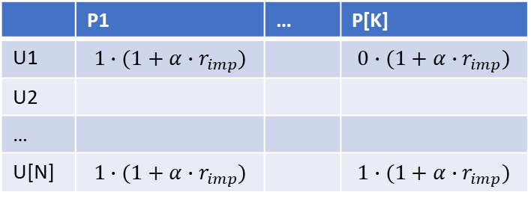
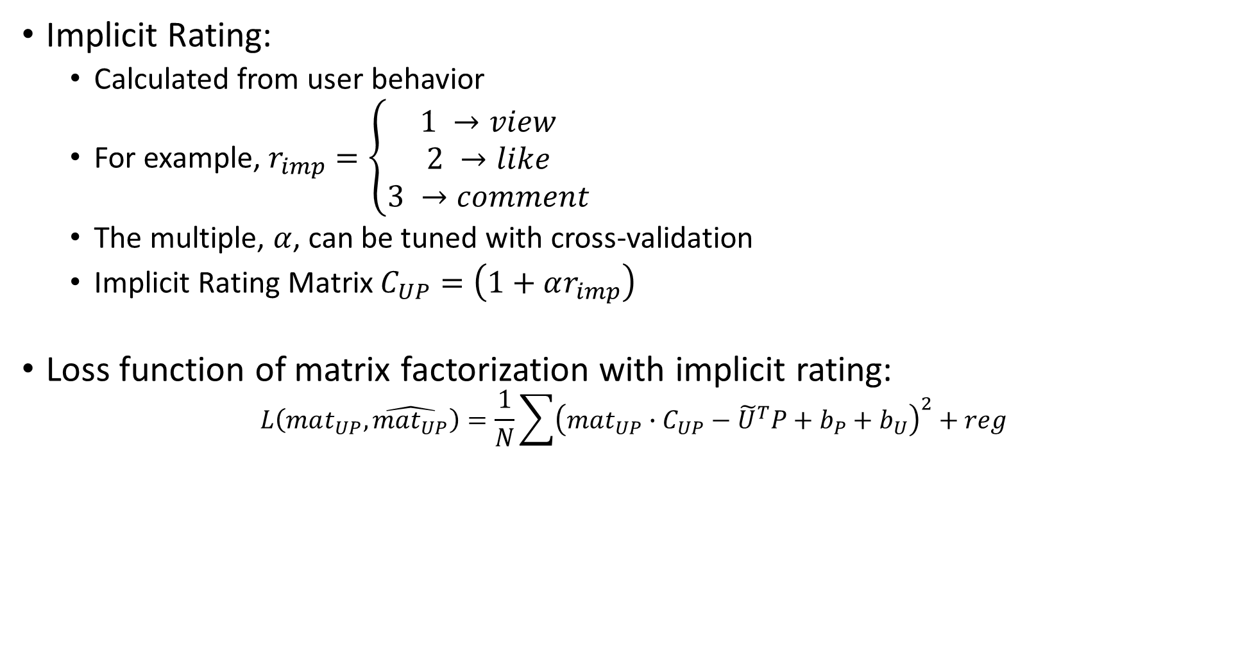
Memory-based Recommender System
Implicit Rating:
Calculated from user behavior
For example, $r_{imp}=\left\{\begin{matrix}1 →view \\ 2 →like \\ 3 →comment\end{matrix}\right.$
The multiple, $α$, can be tuned with cross-validation
Implicit Rating Matrix $C_{UP}=\left(1+αr_{imp}\right)$
Loss function of matrix factorization with implicit rating: $L\left(mat_{UP},\hat{mat_{UP}}\right)=\frac{1}{N}\sum{{\left(mat_{UP}∙C_{UP}−{\tilde{U}}^{T}P+b_{P}+b_{U}\right)}^{2}}+reg$
 | P1 | … | P[K]
U1 | $$1∙(1+α∙r_{imp})$$ |  | $$0∙(1+α∙r_{imp})$$
U2
…
U[N] | $$1∙(1+α∙r_{imp})$$ |  | $$1∙(1+α∙r_{imp})$$

Slide 9
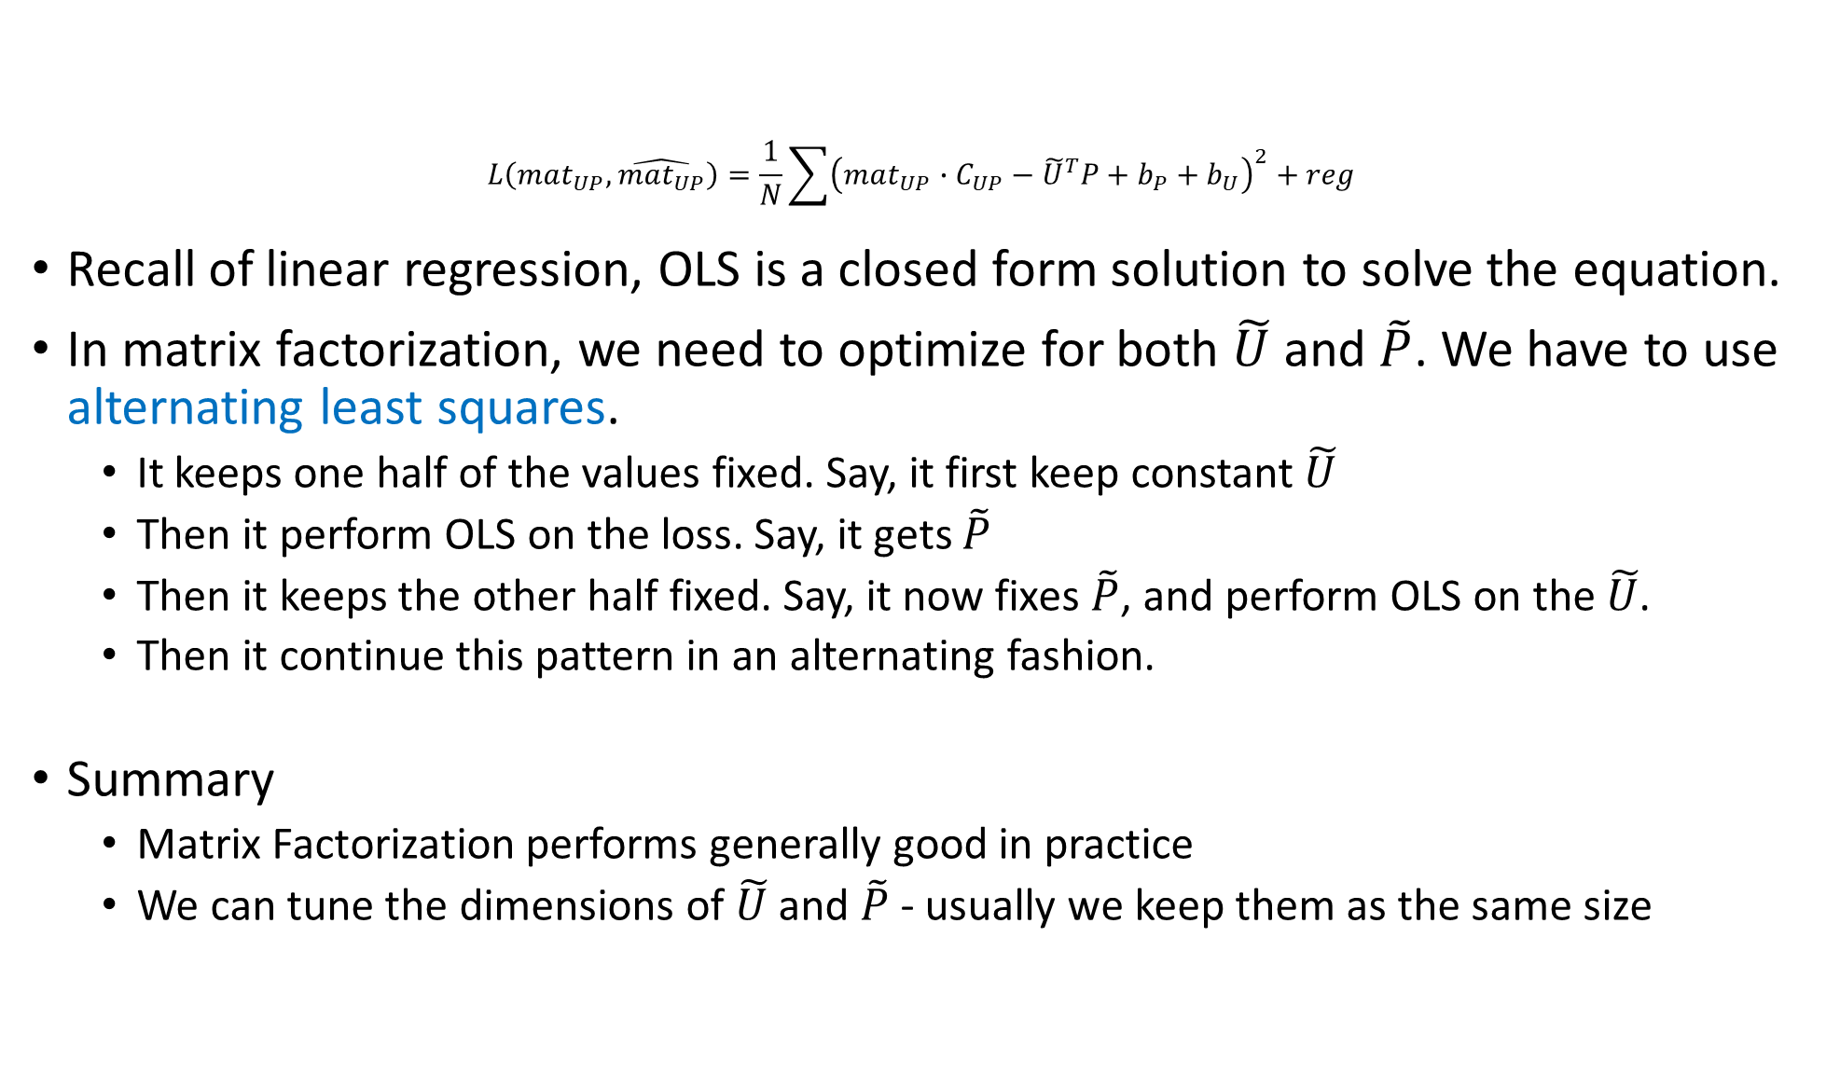
Memory-based Recommender System
$$L\left(mat_{UP},\hat{mat_{UP}}\right)=\frac{1}{N}\sum{{\left(mat_{UP}∙C_{UP}−{\tilde{U}}^{T}P+b_{P}+b_{U}\right)}^{2}}+reg$$
Recall of linear regression, OLS is a closed form solution to solve the equation.
In matrix factorization, we need to optimize for both $\tilde{U}$ and $\tilde{P}$. We have to use alternating least squares.
It keeps one half of the values fixed. Say, it first keep constant $\tilde{U}$
Then it perform OLS on the loss. Say, it gets $\tilde{P}$
Then it keeps the other half fixed. Say, it now fixes $\tilde{P}$, and perform OLS on the $\tilde{U}$.
Then it continue this pattern in an alternating fashion.
Summary
Matrix Factorization performs generally good in practice
We can tune the dimensions of $\tilde{U}$ and $\tilde{P}$ - usually we keep them as the same size

Slide 10
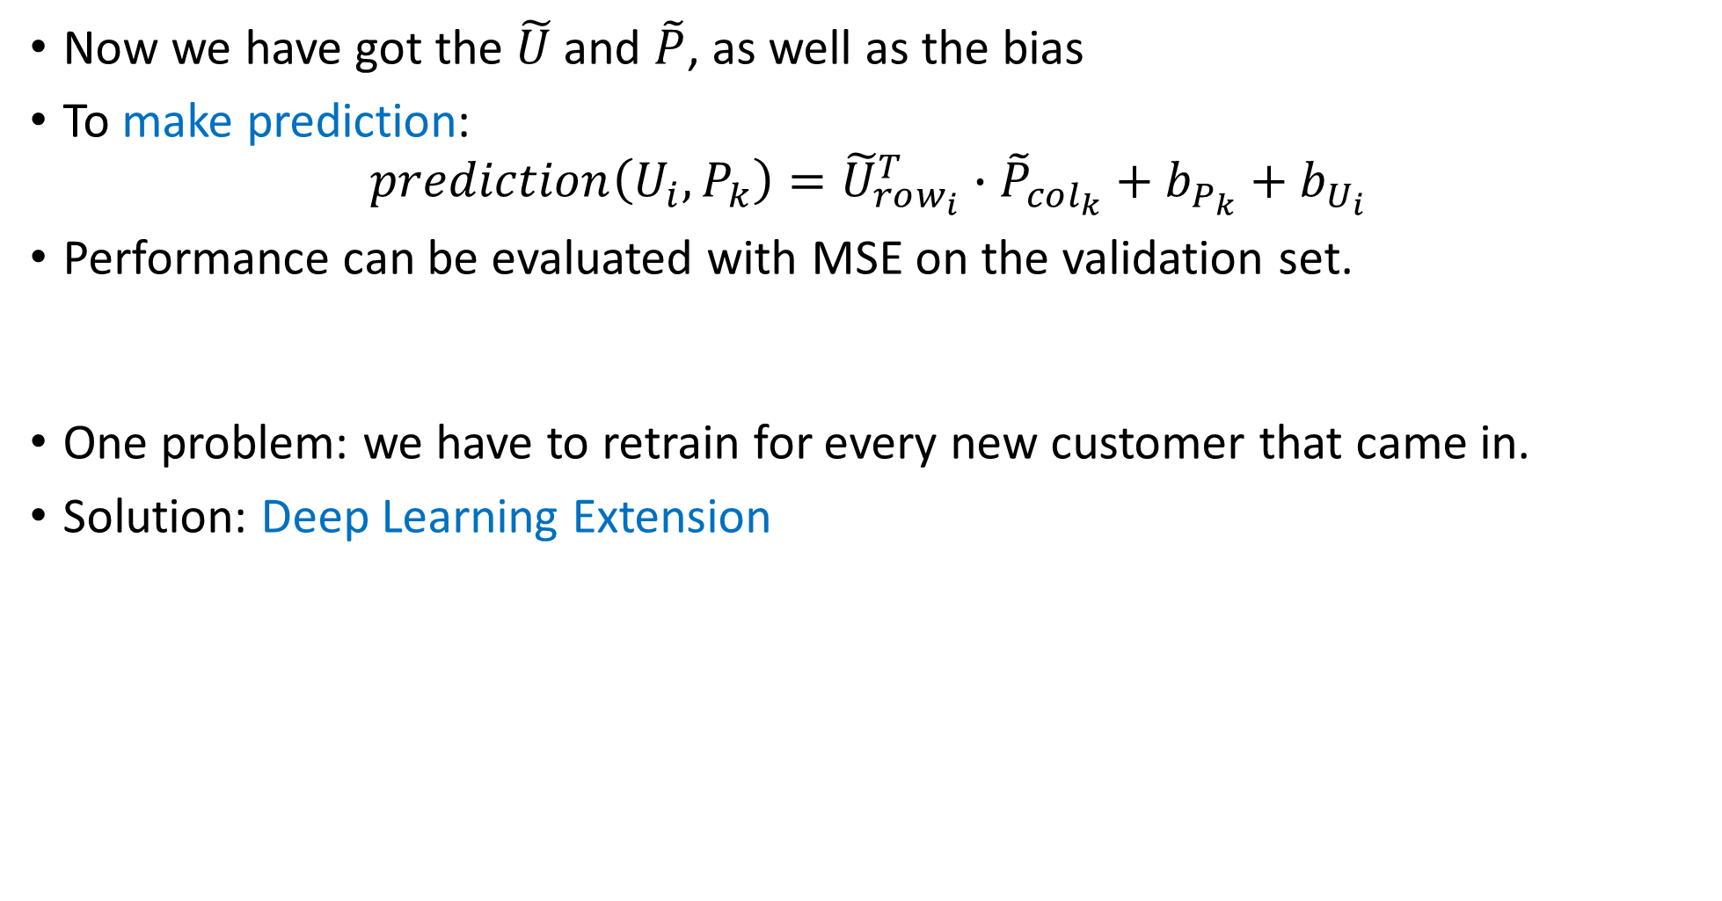
Memory-based Recommender System
Now we have got the $\tilde{U}$ and $\tilde{P}$, as well as the bias
To make prediction: $prediction\left(U_{i},P_{k}\right)={\tilde{U}}_{row_{i}}^{T}∙{\tilde{P}}_{col_{k}}+b_{P_{k}}+b_{U_{i}}$
Performance can be evaluated with MSE on the validation set.
One problem: we have to retrain for every new customer that came in.
Solution: Deep Learning Extension

Slide 11




Deep Learning Extension
$$U_{1}^{1}$$
 | P1 | P2 | … | P[K]
U1
U2
…
U[N]
…
…
$$U_{1}^{K}$$
…
$$P_{K}^{1}$$
…
…
$$P_{K}^{N}$$
Embedding layers
Rows and columns of the user-item matrix serves as the inputs to the NN
Each row/column would have its own separate fully connected layers
These layers act as embedding layers
The results of embeddings will be combined into a single fully connected layer
Finally, sent to an activation function, such as linear activation.
The final output is the prediction for a particular user and item (post)
This typically requires less re-training

Slide 12
Challenges of Collaborative Filtering
Cold Start
New users have no information / New items have no purchases or interactions
Some solution:
Recommending new users popular items
Presenting new items to random (or targeted) subgroups
In general, this is always a problem with collaborative filtering
Echo Chamber
A state of a system in which user behavior is reinforced by the recommendations themselves
For example, recommend an item to a user => increment some values in the user-item matrix => make it have more weight for other users => keeps on spin within this positive feedback loop
As a result, our system will keep on recommending the same / similar items over and over
This will strongly impair the customer experience by reducing the deversity of recommendation
Some solution:
We have to introduce some diversity into our recommendations. For example, pitching random items which are popular in other areas.
Shilling Attack
Users manipulate by inflating / defalting interactions for their own or competitors
People may create many accounts to “like” their posts, or “dislike” their competitor’s posts
Some solution: Allow only one user per phone, etc

Slide 13
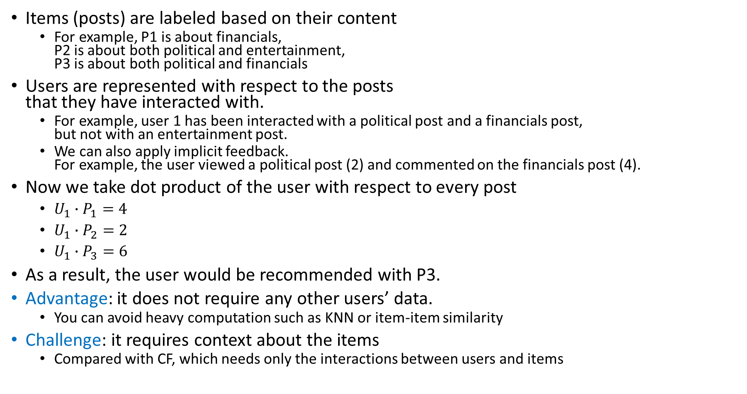
Content-based Filtering
 | Political | Entertainment | Financials
U1 | 2 | 0 | 4
P1 | 0 | 0 | 1
P2 | 1 | 1 | 0
P3 | 1 | 0 | 1
Items (posts) are labeled based on their content
For example, P1 is about financials, P2 is about both political and entertainment, P3 is about both political and financials
Users are represented with respect to the posts that they have interacted with.
For example, user 1 has been interacted with a political post and a financials post, but not with an entertainment post.
We can also apply implicit feedback. For example, the user viewed a political post (2) and commented on the financials post (4).
Now we take dot product of the user with respect to every post
$U_{1}∙P_{1}=4$
$U_{1}∙P_{2}=2$
$U_{1}∙P_{3}=6$
As a result, the user would be recommended with P3.
Advantage: it does not require any other users’ data.
You can avoid heavy computation such as KNN or item-item similarity
Challenge: it requires context about the items
Compared with CF, which needs only the interactions between users and items

Slide 14


Deep Learning Hybrid
We can combine collaborative filtering and content-based filtering using Deep Learning Hybrid.
Let’s start from the deep learning extension of matrix factorization.
Then we add the side features, which are from content-based filtering, such as attributes of user behavior, tags or categories of the post
Each group of features have their own embedding layers
U
…
…
P
…
$$U_{s}$$
…
…
$$P_{s}$$
…

Slide 15
An example of a successful model
Previously, our push notification recommends contents based on popularity only. It had a push notification opening rate was 4.9%
After adopting a recommender using matrix factorization, the opening rate became 9.4%

